Slide 1
Fail-Fast & Fail-Safe Collections

Slide 2
AGENDA
1. What is Fail-Fast?
2. What is Fail-Safe?
3. Fail-Fast Collections in Java (with Code)
4. Fail-Safe Collections in Java (with Code)
5. Deep Dive: ConcurrentModificationException (CME)
How to Avoid CME (5 Techniques)

Slide 3
WHAT IS FAIL-FAST?
Definition
A Fail-Fast system is one that immediately reports any failure or condition that is likely to lead to failure. It does NOT try to continue operating in a potentially broken state.
In Java Collections Context
When you iterate over a Fail-Fast collection and someone modifies the collection structurally (add/remove) during iteration...
The iterator immediately throws ConcurrentModificationException
It does NOT wait. It does NOT silently corrupt data. It FAILS FAST.

Slide 4
Real-World Analogy 🏭
Imagine a FACTORY ASSEMBLY LINE:
🔧 A robot is inspecting items on a conveyor belt (Iterator)
🚫 Someone suddenly ADDS a new item in the middle of the belt
⚠️ The robot IMMEDIATELY STOPS and raises an ALARM
It does NOT continue inspecting — because the belt changed
and results would be unreliable.
THIS IS FAIL-FAST BEHAVIOR.
Key Characteristics
✅ Detects modification IMMEDIATELY
✅ Throws ConcurrentModificationException
✅ Works on the ORIGINAL collection (no copy)
✅ Uses internal counter called "modCount"
✅ NOT guaranteed in all cases (best-effort)

Slide 5
WHAT IS FAIL-SAFE?
Definition
A Fail-Safe system is one that does NOT throw an exception when the collection is modified during iteration. It operates on a clone/snapshot of the collection..
In Java Collections Context
When you iterate over a Fail-Safe collection and someone modifies it...
The iterator continues without any exception
It works on a copy/snapshot of the data
You may NOT see the latest modifications during iteration

Slide 6
Real-World Analogy 🏭
Imagine you take a PHOTOCOPY of a DOCUMENT:
📄 Original document is on the table
📋 You take a PHOTOCOPY and start reading it
✏️ Someone EDITS the original document while you read
You DON'T notice the changes — you're reading the COPY.
You DON'T get interrupted. You finish reading peacefully.
But you might have STALE/OLD data.
THIS IS FAIL-SAFE BEHAVIOR.
Key Characteristics
✅ Does NOT throw ConcurrentModificationException
✅ Works on a CLONE/COPY of the collection
✅ Safe for concurrent modification
✅ Higher MEMORY usage (because of cloning)
✅ May show STALE data (not real-time)

Slide 7
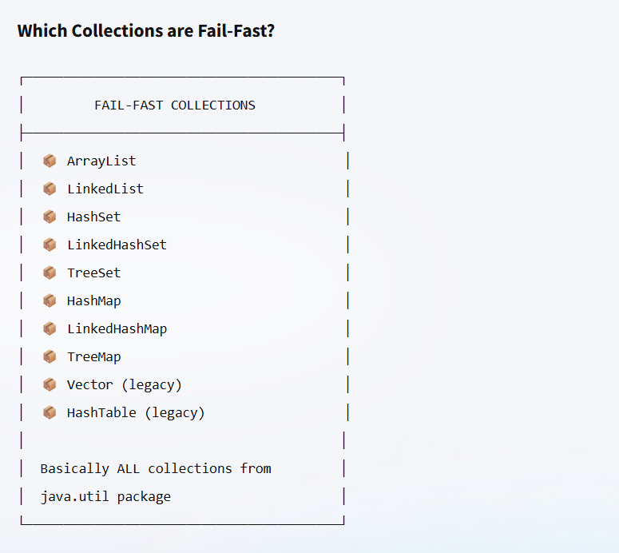
FAIL-FAST COLLECTIONS IN JAVA

Slide 8
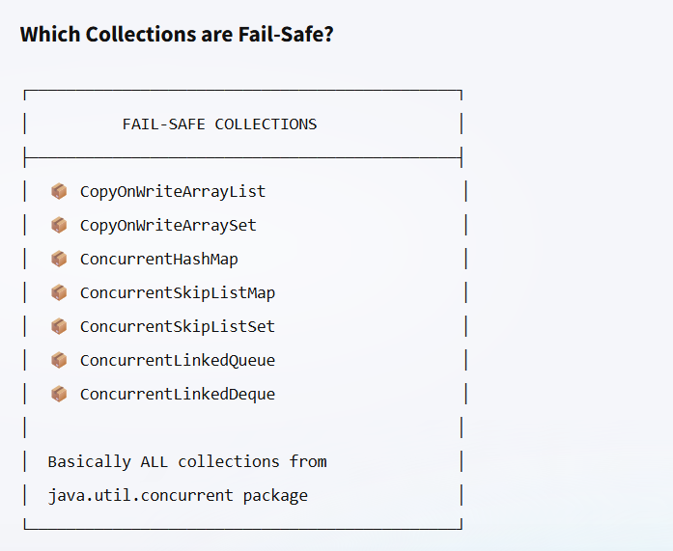
FAIL-SAFE COLLECTIONS IN JAVA

Slide 9
Concurrent Modification Exception (CME)
Package : java.util
Extends : RuntimeException (Unchecked Exception)
Since : JDK 1.2
Thrown when a collection is STRUCTURALLY MODIFIED while an iterator is actively iterating over it.
⚠️ "Concurrent" does NOT necessarily mean multi-threading! It can happen in a SINGLE thread!

Slide 10
What is a "Structural Modification"?
STRUCTURAL MODIFICATION (triggers CME):
✅ add()
✅ remove()
✅ clear()
✅ addAll()
✅ retainAll() NOT STRUCTURAL MODIFICATION (does NOT trigger CME):
❌ set(index, element) — replaces, doesn't change size
❌ Changing an object's internal state
e.g., employee.setName("New Name")

Slide 11
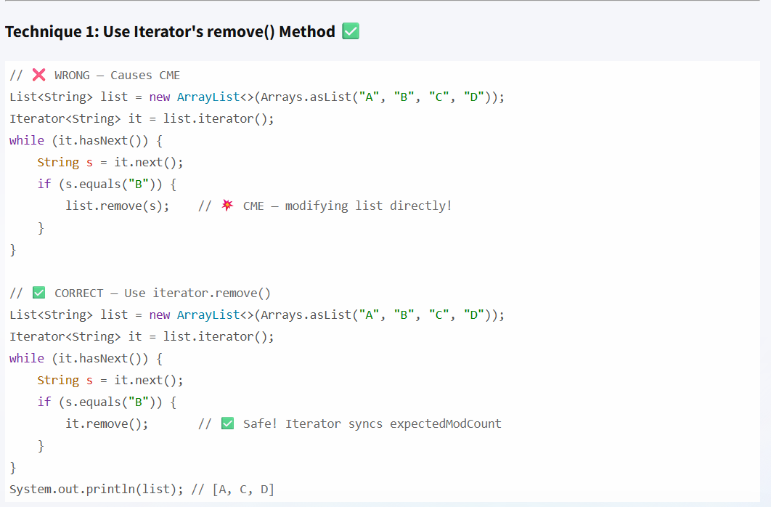
HOW TO AVOID CME (5 TECHNIQUES)
Why does it.remove() work?
Because iterator.remove() internally does:
1. Removes the element from the collection
2. Sets expectedModCount = modCount ← RE-SYNCS!
So the next check will pass.

Slide 12
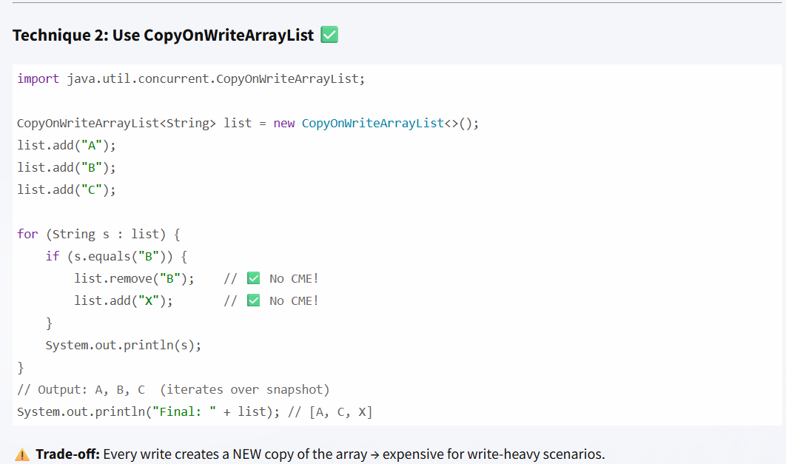

Slide 13
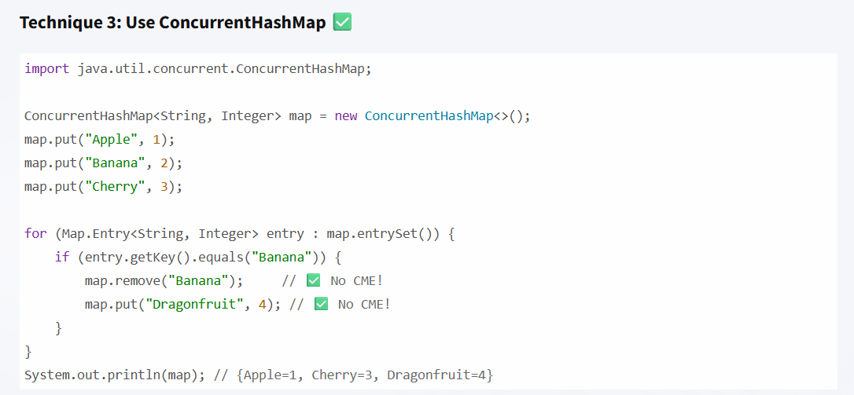
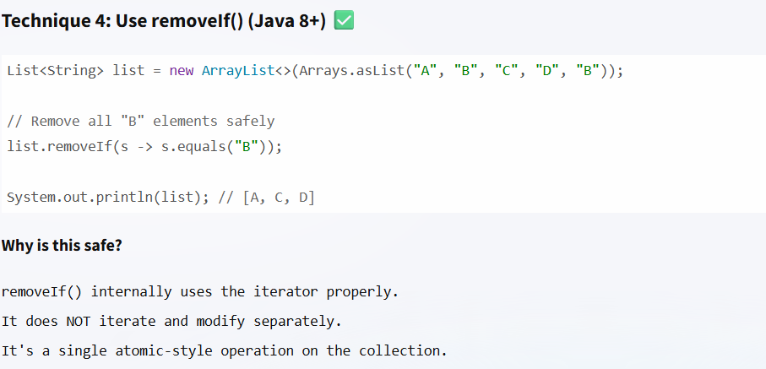

Slide 14
